Slide 1
50.003: Elements of Software Construction
Week 6
Basics of Concurrency: Requirements

Slide 2
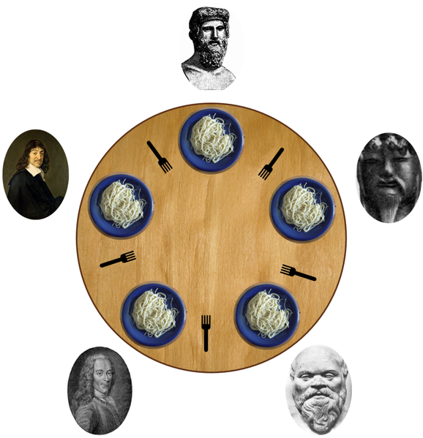
Problem 4: Deadlock
0
Each philosopher needs two forks to eat.
Each philosopher picks the one on the left first.
4
0
4
1
3
1
2
2
3

Slide 3
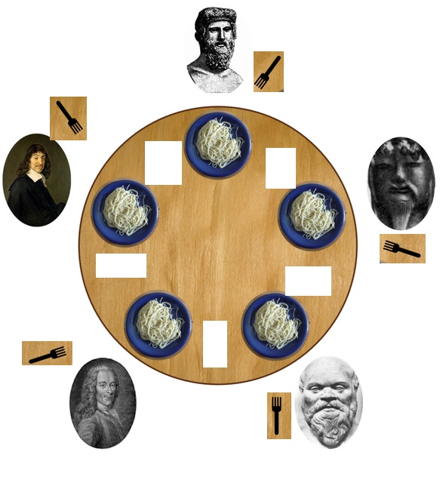
Deadlock
Deadlock is the situation when two or more threads are both waiting for the others to complete, forever.

Slide 4
Lock-Ordering Deadlock
public class LeftRightDeadlock {
private final Object left = new Object ();
private final Object right = new Object ();
public void leftRight () {
synchronized (left) {
synchronized (right) {
doSomething();
}
}
}
public void rightLeft () {
synchronized (right) {
synchronized (left) {
doSomethingElse();
}
}
}
}
Thread A
Thread B
lock left
lock right
try to lock right
wait for lock left
wait forever
wait forever

Slide 5
Example
public void transferMoney (Account from, Account to, int amount) {
synchronized (from) {
synchronized (to) {
if (from.getBalance() < amount) {
//raiseException
}
else {
from.debit(amount);
to.credit(amount)
}
}
}
}
Is it deadlocking?

Slide 6
Example
public void transferMoney (Account from, Account to, int amount) {
synchronized (from) {
synchronized (to) {
if (from.getBalance() < amount) {
//raiseException
}
else {
from.debit(amount);
to.credit(amount)
}
}
}
}
How can transferMoney deadlock?
Thread A: transferMoney(myAccount, yourAccount, 1)
Thread B: transferMoney(yourAccount, myAccount, 1)
Check out: DemonstrateDeadlock.java

Slide 7
Cohort Exercise 5
Given DLExample.java, explain whether it is possibly deadlocking.
In what sequence of execution order leads to deadlock?
Write a test case which potentially demos the deadlock.
Name your solution: DiningPhilDemo.java

Slide 8
Other Liveness Hazards
Deadlock is the most widely encountered liveness hazard.
Starvation occurs when a thread is denied access to resources it needs in order to make progress.
Often caused by use of thread priority or executing infinite loops with a lock held.
Avoid using thread priority, since they increase platform
dependence and can cause liveness problems.

Slide 9
Other Liveness Hazards (cont’d)
Poor responsiveness
may be caused by poor lock management.
Livelock: a thread, while not blocked, still cannot make progress because it keeps retrying an operation that will always fail.
e.g., when two overly polite people are walking in the opposite direction in a hallway.

Slide 10
Requirements
Multi-threaded programs have at least the following additional requirements.
No race condition
No visibility issue
No execution ordering problem
No deadlocks
Efficiency!
How do we make sure our multi-threaded program satisfies these requirements?

Slide 11
Thread Safety
If an object of type A is to be shared by multiple threads, A must be thread safe.
“A class is thread-safe if no set of operations performs sequentially or concurrently on instances of a thread-safe class can cause an instance to be in an invalid state***.” (Java Concurrency in Practice, Chapter 2)
*** whether a state is valid or not is defined by the specification

Slide 12
Specification
What is a “valid state” depends on the specification on the class, which can be captured using:
class invariants
pre-condition/post-condition
assertions
Example: Stack.java

Slide 13
Why Is Race Condition Often Bad?
Post-condition: count’ = count+2
00
r2
r1
01
10
Thread1
Thread2
i2
i1
0
0
02
11
20
r1
r2
w2
w1
03
12
21
30
1
1
r1
r2
i1
i2
13
22
31
2
2
i1
i2
23
32
w1
w2
w1
w2
3
3
33

Slide 14
Requirements
Multi-threaded programs have at least the following additional requirements.
Thread-safety
No visibility issue
No execution ordering problem
No deadlocks
Efficiency!
How do we make sure our multi-threaded program satisfies these requirements?

Slide 15
Remedy: Visibility Issue
Volatile Variables
An update to a volatile variable is propagated predictably to other threads.
Example: NoVisibility.java
private static volatile boolean ready;
…
while (!ready) {
Thread.yield();
}
…

Slide 16
Remedy: Visibility Issue
Visibility guarantees for synchronization
Always use the proper synchronization whenever data is shared across threads.
thread A
…
…
…
Everything before unlock on M
…
unlock M
lock M
… is visible to everything after
the lock on M
…
…
…

Slide 17
Example
What is the problem here?
public class MutableInteger {
private int value;
public int get() { return value; }
public void set(int value) { this.value = value;}
}
public class MutableInteger {
private int value;
public synchronized int get() { return value; }
public synchronized void set(int value) { this.value = value;}
}

Slide 18
Locking and Visibility
Locking is not just about mutual exclusion; it is also about memory visibility. To ensure that all threads see the most up-to-date values of shared mutable variables, the reading and writing threads must synchronize on a common lock.

Slide 19
Cohort Exercise 6
Fix Experiment.java with using volatile.
Name your solution: ExperimentFix1.java
Fix Experiment.java through locking.
Name your solution: ExperimentFix2.java

Slide 20
Remedy: Execution Ordering
If you do want unexpected execution ordering of statements across threads, apply locking.
Thread 1 | Thread 2
1: r2 = A; | 3: r1 = B;
2: B = 1; | 4: A = 2;

Slide 21
Remedy for Deadlock
A program that never acquires more than one lock at a time cannot experience lock-ordering deadlocks.
Strive to use open calls (calling a method with no locks held) throughout your program
Sample program: DLExampleFixed.java

Slide 22
Remedy for Deadlock
A program will be free of lock-ordering deadlocks if all threads acquire the locks they need in a fixed global order.
Is this deadlocking? Thread A locks a, b, c, d, e in the sequence and thread B locks c, f, e.
Is this deadlocking? Thread A locks a, b, c, d, e in the sequence and thread B locks e, f, c.
public void transferMoney (Account from, Account to) {
synchronized (from) {
synchronized (to) {
……
}
}
}
Click here for a sample program: TransferFixed.java

Slide 23
Avoid Deadlocks
Use the timed tryLock feature of the explicit Lock class instead of intrinsic locking.
Sample program: Trylockexample.java

Slide 24
Cohort Exercise 7
Fix DiningPhil.java by making it deadlock-free, in two different ways.
fixed global order
avoid deadlocks

